Slide 1
LWC Training
Debug/Deploy Lightning Web Component
April 26, 2019
Day 5: Debug/Deploy Lightning Web Component

Slide 2
Agenda
agenda
Debug Modes
Chrome Dev Tools Debugging
Deploying LWC
References

Slide 3
Debug Modes

Slide 4
Debug Modes
Technical Design
Production
Default Mode.
Optimizes performance by minification and proxies
Debug
We need to enable debug mode for specific user/developer.
Framework JavaScript code isn’t minified and is easier to read and debug.
This mode also adds more detailed output for warnings and errors.

Slide 5
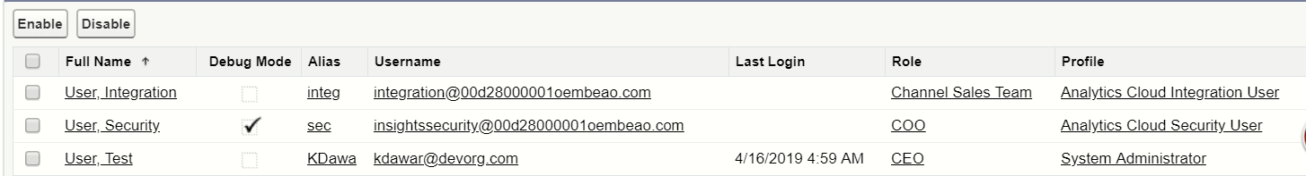
Enable Debug Mode
Technical Design
To enable/disable debug mode for users in your org:
In Salesforce, from Setup, enter Debug Mode in the Quick Find box, then select Debug Mode Users. Users with debug mode enabled have a check mark in the Debug Mode column.
In the user list, locate any users who need debug mode enabled. If necessary, use the standard list view controls to filter your org’s users.
Enable the selection checkbox next to users for whom you want to enable debug mode
Click Enable/Disable
Debug Mode Already Enabled

Slide 6
Chrome Dev Tools for Debugging

Slide 7


Chrome DevTools Debugging
Technical Design
Lightning Web Components in Production Mode provide you with two things-
Minified Javascript :
Minification is JavaScript compression into as few bytes as possible by removing any unnecessary characters and elements like line breaks, whitespace, tabs, code comments, etc.
Minification changes the names of functions or variables.
Post Minification

Slide 8
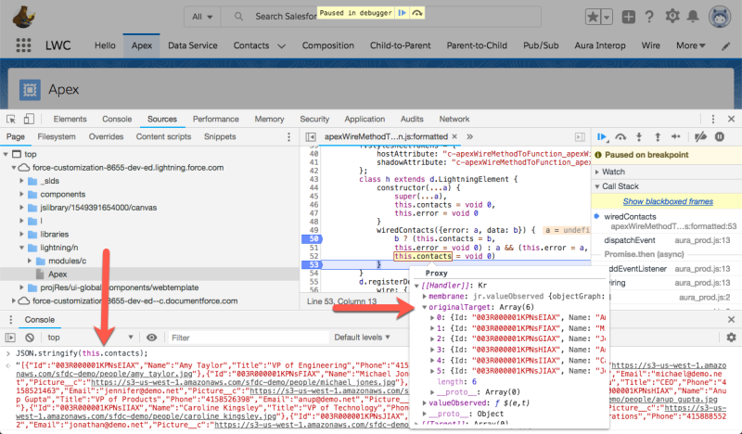
Chrome DevTools Debugging (cont.)
Technical Design
Proxied Values:
Proxied data is provisioned via decorators (@api, @track, @wire). By using JavaScript Proxies, we make sure they remain read only. Either use JSON.stringify() or inspect the object structure for reading Proxy object

Slide 9
Chrome DevTools Debugging(cont.)
Technical Design
Lightning Web Components in Debug Mode provide you with two things-
Unminified Javascript :
The mapping from what’s in your IDE to browser is close to 1:1.
Especially in longer JavaScript classes you don’t have to guess, or remember, what variable d was again — you’ll now see the name as it lives in your source code.
Console engine warnings
In debug mode, the Lightning Web Components engine actually identifies bad patterns that are only detectable during runtime, and then prints them as console warnings.

Slide 10
Deploying LWC

Slide 11

Deployment through Command Line Interface (CLI)
Technical Design
Sfdx force:lightning:component:create --type lwc --name <nameOfLightningComponent>
Sfdx force:source:push –targetusername <username/alias> [Scratch Org]
Sfdx force:source:deploy --targetusername <username/alias> --sourcepath <pathToLWC> [Non- Scratch Org]
Deployment through Ant Migration Tool
Metadata Type - LightningComponentBundle

Slide 12
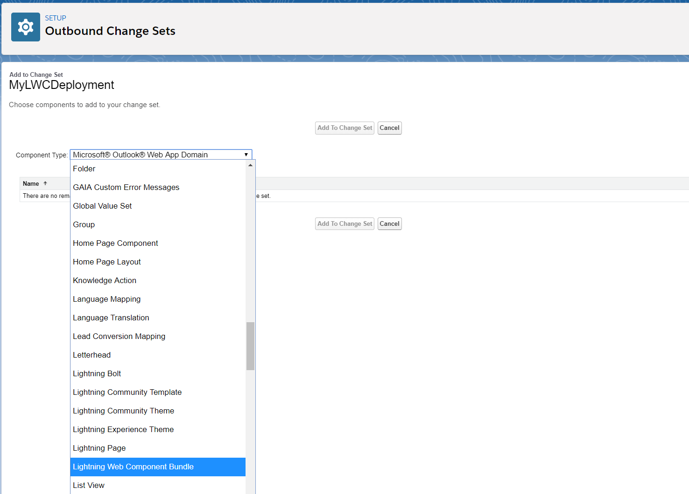
Deployment through Change Sets
Technical Design
Lightning Web Component Bundle cane be used deploy through change sets.

Slide 13
Questions

Slide 14
In which mode do you see the Minified Javascript using Chrome tools for debugging?
Production 2. Debug 3. Both
In which mode do you see the Console Engine warnings using Chrome tools for debugging?
Production 2. Debug 3. Both
We can deploy Lightning web components to a SF environment using.
SFDX CLI
ANT Migration tool
Change sets
All of the above
What is the metadata type to be specified in the package.xml to deploy LWC?
AuraDefinitionBundle 2. WebComponentBundle 3. LightningComponentBundle 4. lwc

Slide 15
References
Technical Design
Lightning Web Component Bundle cane be used deploy through change sets.
VS Code inline commands:
https://developer.salesforce.com/docs/atlas.en-us.sfdx_cli_reference.meta/sfdx_cli_reference/cli_reference_force_org.htm
LWC Documentation:
https://developer.salesforce.com/docs/component-library/documentation/lwc/lwc.debug_mode_enable
LWC Video Library:
https://developer.salesforce.com/tv/lwc-video-gallery
Google Dev Tools Javascript Debugging:
https://developers.google.com/web/tools/chrome-devtools/javascript

